Slide 1
Chapter 6
Introduction to Structured Query Language (SQL)
Database Systems:
Design, Implementation, and Management, Sixth Edition, Rob and Coronel

Slide 2
Introduction to SQL
SQL functions fit into two broad categories:
Data definition language
  SQL includes commands to create
    Database objects such as tables, indexes, and views
    Commands to define access rights to those database objects
Data manipulation language
  Includes commands to insert, update, delete, and retrieve data within the database tables

Slide 3
Introduction to SQ L
SQL is relatively easy to learn
Basic command set has a vocabulary of less than 100 words
Nonprocedural language
American National Standards Institute (ANSI) prescribes a standard SQL
Several SQL dialects exist

Slide 4
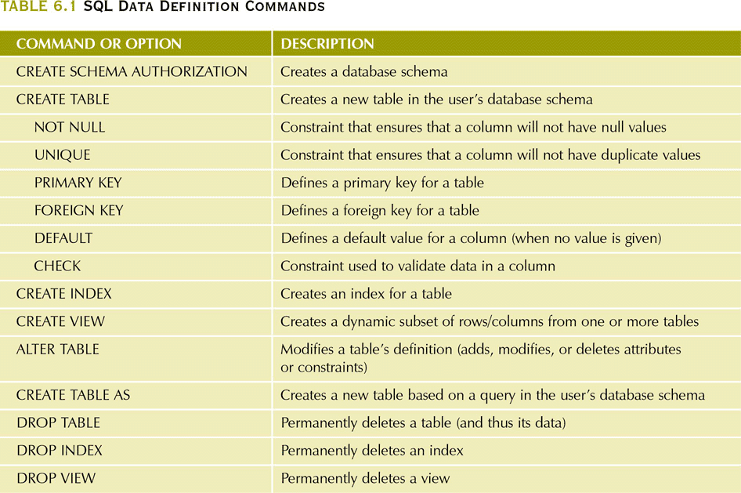
SQL Data Definition Commands

Slide 5
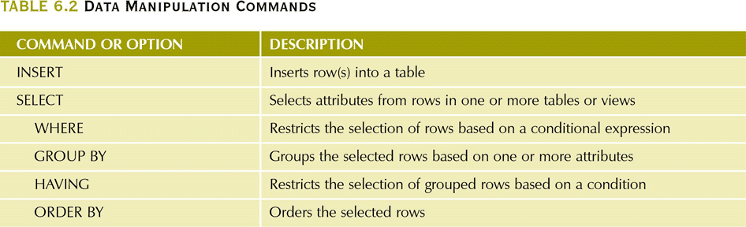
Data Manipulation Commands

Slide 6
Data Definition Commands
Examine the simple database model and the database tables that will form the basis for the many SQL examples
Understand the data environment

Slide 7
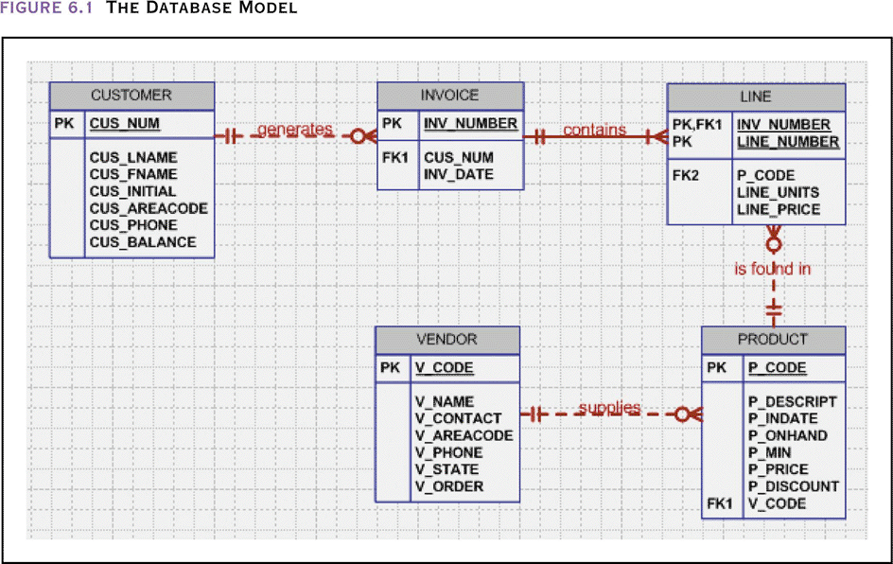
The Database Model

Slide 8
The Database Model
Reflects the following business rules
  A customer may generate one or more invoices; each invoice is generated by one customer
  An invoice contains one or more invoice lines; each invoice line is associated with one invoice
  Each invoice line references one product; a product may be found in many invoice lines
  A vendor may supply many products; some vendors do not yet supply products
  If a product is vendor-supplied, that product is supplied by only a single vendor
  Some products are not supplied by a vendor (in-house or bought on the open market)

Slide 9
The Database Model
P_CODE | P_DESCRIPT | P_INDATE | P_ONHAND | P_MIN | P_PRICE | P_DISCOUNT | V_CODE
11QER/31 | Power painter, 15 psi., 3-nozzle | 03-Nov-03 | 8 | 5 | $109.99 | 0.00 | 25595
13-Q2/P2 | 7.25-in. pwr. saw blade | 13-Dec-03 | 32 | 15 | $14.99 | 0.05 | 21344
14-Q1/L3 | 9.00-in. pwr. saw blade | 13-Nov-03 | 18 | 12 | $17.49 | 0.00 | 21344
1546-QQ2 | Hrd. cloth, 1/4-in., 2x50 | 15-Jan-04 | 15 | 8 | $39.95 | 0.00 | 23119
1558-QW1 | Hrd. cloth, 1/2-in., 3x50 | 15-Jan-04 | 23 | 5 | $43.99 | 0.00 | 23119
2232/QTY | B&D jigsaw, 12-in. blade | 30-Dec-03 | 8 | 5 | $109.92 | 0.05 | 24288
2232/QWE | B&D jigsaw, 8-in. blade | 24-Dec-03 | 6 | 5 | $99.87 | 0.05 | 24288
2238/QPD | B&D cordless drill, 1/2-in. | 20-Jan-04 | 12 | 5 | $38.95 | 0.05 | 25595
23109-HB | Claw hammer | 20-Jan-04 | 23 | 10 | $9.95 | 0.10 | 21225
23114-AA | Sledge hammer, 12 lb. | 02-Jan-04 | 8 | 5 | $14.40 | 0.05
54778-2T | Rat-tail file, 1/8-in. fine | 15-Dec-03 | 43 | 20 | $4.99 | 0.00 | 21344
89-WRE-Q | Hicut chain saw, 16 in. | 07-Feb-04 | 11 | 5 | $256.99 | 0.05 | 24288
PVC23DRT | PVC pipe, 3.5-in., 8-ft | 20-Feb-04 | 188 | 75 | $5.87 | 0.00
SM-18277 | 1.25-in. metal screw, 25 | 01-Mar-04 | 172 | 75 | $6.99 | 0.00 | 21225
SW-23116 | 2.5-in. wd. screw, 50 | 24-Feb-04 | 237 | 100 | $8.45 | 0.00 | 21231
WR3/TT3 | Steel matting, 4'x8'x1/6", .5" mesh | 17-Jan-04 | 18 | 5 | $119.95 | 0.10 | 25595
PRODUCT
V_CODE | V_NAME | V_CONTACT | V_AREACODE | V_PHONE | V_STATE | V_ORDER
21225 | Bryson, Inc. | Smithson | 615 | 223-3234 | TN | Y
21226 | SuperLoo, Inc. | Flushing | 904 | 215-8995 | FL | N
21231 | D&E Supply | Singh | 615 | 228-3245 | TN | Y
21344 | Gomez Bros. | Ortega | 615 | 889-2546 | KY | N
22567 | Dome Supply | Smith | 901 | 678-1419 | GA | N
23119 | Randsets Ltd. | Anderson | 901 | 678-3998 | GA | Y
24004 | Brackman Bros. | Browning | 615 | 228-1410 | TN | N
24288 | ORDVA, Inc. | Hakford | 615 | 898-1234 | TN | Y
25443 | B&K, Inc. | Smith | 904 | 227-0093 | FL | N
25501 | Damal Supplies | Smythe | 615 | 890-3529 | TN | N
25595 | Rubicon Systems | Orton | 904 | 456-0092 | FL | Y

Slide 10
The Database Model
Note the following regarding VENDOR and PRODUCTS
  The VENDOR table contains vendors who are not referenced in the PRODUCTS table
    PRODUCT is optional to VENDOR
  Exisiting V_CODE values in the PRODUCT table must have a match in the VENDOR table to ensure referential integrity
  A few products are supplied factory-direct, a few are made in-house and a few have been bought in a special warehouse sale. Thus, a product is not necessarily supplied by a vendor – VENDOR is optional to PRODUCT

Slide 11
Creating the Database
Two tasks must be completed
  create the database structure
  create the tables that will hold the end-user data
First task
  RDBMS creates the physical files that will hold the database
  Tends to differ substantially from one RDBMS to another

Slide 12
The Database Schema
Authentication
  Process through which the DBMS verifies that only registered users are able to access the database
  Log on to the RDBMS using a user ID and a password created by the database administrator
Schema
  Logical grouping of database objects—such as tables and indexes—that are related to each other

Slide 13
Data Types
Data type selection is usually dictated by the nature of the data and by the intended use
Pay close attention to the expected use of attributes for sorting and data retrieval purposes
  A field that is all numeric, but upon which no mathematical computation will be performed, should be stored as character for faster query processing.
  However, if you sort on a number stored as character, 10 will come before 2 because of the ANSI character comparison (e.g., number of bedrooms)

Slide 14
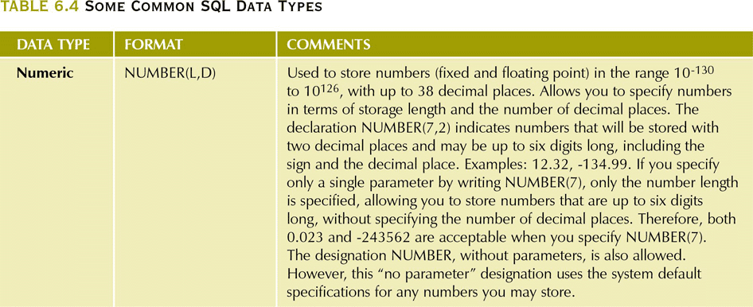
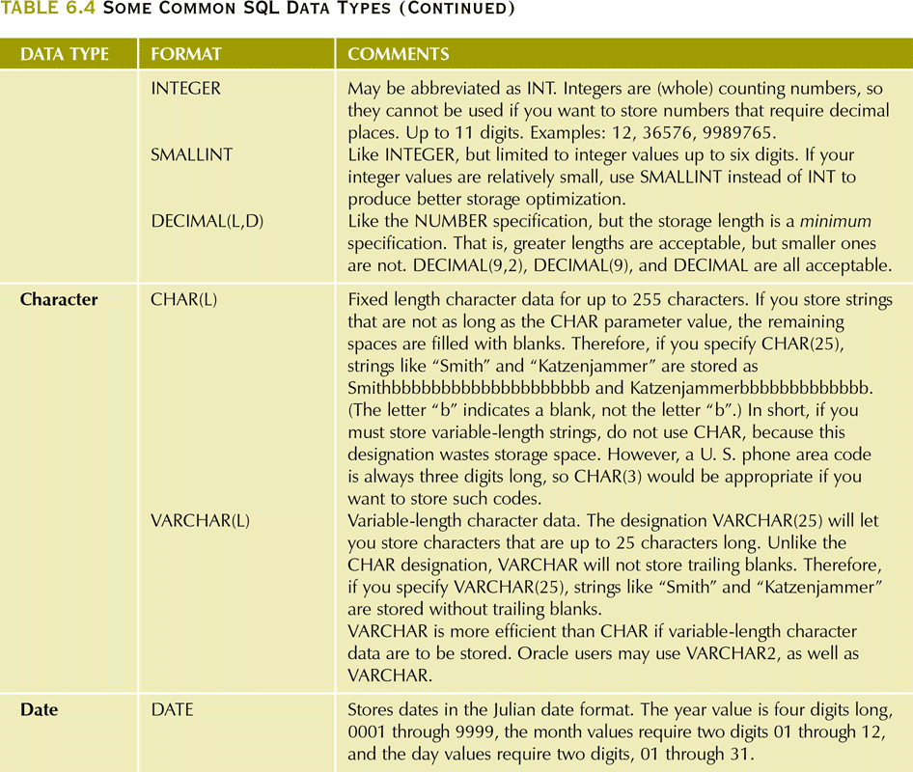
Some Common SQL Data Types

Slide 15
Creating Table Structures
CREATE TABLE VENDOR (
V_CODE INTEGER NOT NULL UNIQUE,
V_NAME VARCHAR(35) NOT NULL,
V_CONTACT VARCHAR(15) NOT NULL,
V_AREACODE CHAR(3) NOT NULL,
V_PHONE CHAR(8) NOT NULL,
V_STATE CHAR(2) NOT NULL,
V_ORDER CHAR(1) NOT NULL,
PRIMARY KEY (V_CODE));
CREATE TABLE PRODUCT (
P_CODE VARCHAR(10) NOT NULL UNIQUE,
P_DESCRIPT VARCHAR2(35) NOT NULL,
P_INDATE DATE NOT NULL,
P_ONHAND SMALLINT NOT NULL,
P_MIN SMALLINT NOT NULL,
P_PRICE NUMBER(8,2) NOT NULL,
P_DISCOUNT NUMBER(4,2) NOT NULL,
V_CODE INTEGER,
PRIMARY KEY(P_CODE),
FOREIGN KEY (V_CODE) REFERENCES VENDOR
ON UPDATE(CASCADE));

Slide 16
Creating Table Structures
Use one line per column (attribute) definition
Use spaces to line up the attribute characteristics and constraints
Table and attribute names are capitalized
NOT NULL specification
UNIQUE specification
Primary key attributes contain both a NOT NULL and a UNIQUE specification
RDBMS will automatically enforce referential integrity for foreign keys
Command sequence ends with a semicolon

Slide 17
Other SQL Constraints
NOT NULL constraint
  Ensures that a column does not accept nulls
UNIQUE constraint
  Ensures that all values in a column are unique
DEFAULT constraint
  Assigns a value to an attribute when a new row is added to a table
CHECK constraint
  Validates data when an attribute value is entered
ON UPDATE CASCADE
  Ensures that a change any VENDOR’s V_CODE will automatically be applied to all FK references throughout the system
  Also have ON DELETE CASCADE and ON UPDATE CASCADE

Slide 18
SQL Constraint Examples
CUS_AREACODE CHAR(3) DEFAULT ‘615’ NOT NULL CHECK (CUS_AREACODE IN (‘615’,’713’,’931’)),
  DEFAULT value applies only when new rows are added to a table and only if no value is entered for that field
  CHECK is always validated when a row id added or modified
CUS_BALANCE NUMBER(9,2) DEFAULT 0.00,
CONSTRAINT CUS_UI1 UNIQUE(CUS_LNAME,CUS_FNAME)

Slide 19
SQL Constraint Examples
CREATE TABLE INVOICE(
INV_NUMBER NUMBER PRIMARY KEY,
CUS_CODE NUMBER NOT NULL
REFERENCES CUSTOMER(CUS_CODE),
INV_DATE DATE DEFAULT SYSDATE NOT NULL,
CONSTRAINT INV_CK1 CHECK(INV_DATE > TO_DATE(’01-JAN-2002’,’DD-MON-YYYY’)));

Slide 20
SQL Constraint Examples
CREATE TABLE LINE(
INV_NUMBER NUMBER NOT NULL,
LINE_NUMBER NUMBER(2,0)NOT NULL,
P_CODE VARCHAR(10) NOT NULL,
LINE_UNITS NUMBER(9,2) DEFAULT 0.00 NOT NULL,
LINE_PRICE NUMBER(9,2) DEFAULT 0.00 NOT NULL,
PRIMARY KEY(INV_NUMBER, LINE_NUMBER),
FOREIGN KEY(INV_NUMBER) REFERENCES INVOICE ON DELETE CASCADE,
FOREIGN KEY(P_CODE) REFERENCES PRODUCT(P_CODE),
CONSTRAINT LINE_UI1 UNIQUE(INV_NUMBER,P_CODE));
ON DELETE CASCADE recommended for weak entities to ensure that the deletion of a row in the strong entity automatically triggers the deletion of the corresponding rows in the dependent weak entity DEFAULT value applies only when new rows are added to a table and only if no value is entered for that field
  Deletion of an INVOICE row will automatically delete all the LINE rows related to that invoice

Slide 21
SQL Indexes
When a primary key is declared, DBMS automatically creates a unique index
Often need additional indexes
Using the CREATE INDEX command, SQL indexes can be created on the basis of any selected attribute
  CREATE [UNIQUE] INDEX P_CODEX ON PRODUCT(P_CODE);
Composite index
  Index based on two or more attributes, ordered left to right
    KEY(INV_NUMBER, LINE_NUMBER)
  Often used to prevent data duplication

Slide 22
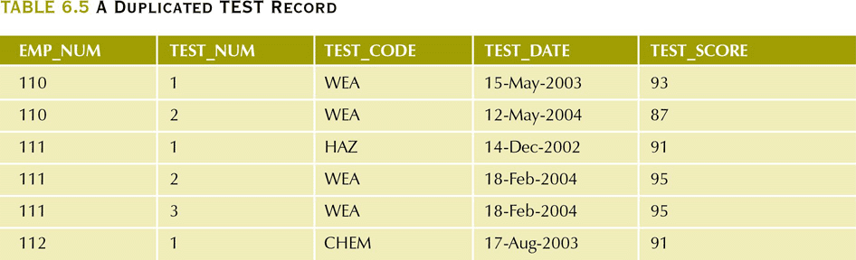
A Duplicated TEST Record
CREATE UNIQUE INDEX EMP_TESTDEX ON TEST(EMP_NUM,TEST_CODE,TEST_DATE);
This will allow the use of a candidate key as a unique index

Slide 23
SQL Indexes
The default ordering for an index is ascending. It can be changed to descending by adding DESC after the field name
  CREATE INDEX PROD_PRICEX ON PRODUCT(P_PRICE DESC);
Delete an index with DROP INDEX indexname;

Slide 24
Data Manipulation Commands
Adding table rows
Saving table changes
Listing table rows
Updating table rows
Restoring table contents
Deleting table rows
Inserting table rows with a select subquery

Slide 25
Data Manipulation Commands
INSERT INTO tablename VALUES( value1, value2, … valueN)
  String and date values must be entered between apostrophes
  Numerical entries are nit enclosed in apostrophes
  Attribute entries are separated by commas
  A value is required for each column in the table
  Fields that accept NULL values can be set through INSERT
  You can specify the field names and then just supply those values
    INSERT INTO PRODUCT(P_CODE, P_DESCRIPT) VALUES (‘BRT-45’, ‘Titanium drill bit’);

Slide 26
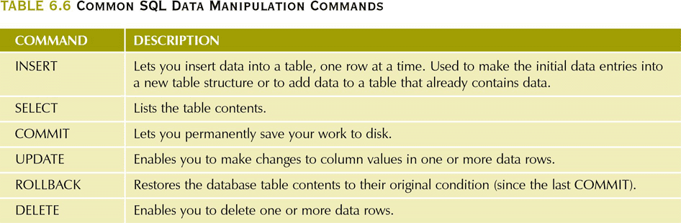
Common SQL Data Manipulation Commands

Slide 27
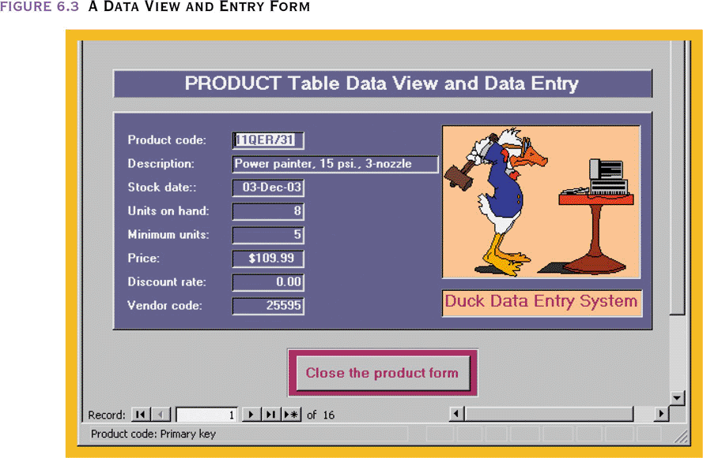
A Data View and Entry Form

Slide 28
Saving Table Changes
Changes made to table contents are not physically saved on disk until
  Database is closed
  Program is closed
  COMMIT command is used
Syntax
  COMMIT [WORK]
Will permanently save any changes made to any table in the database

Slide 29
Listing Table Rows
SELECT
  Used to list contents of table
Syntax
  SELECT columnlist
  FROM tablename
columnlist represents one or more attributes, separated by commas
Asterisk can be used as wildcard character to list all attributes

Slide 30
Updating Table Rows
UPDATE - Modify data in a table
  UPDATE tablename
  SET columnname = expression [, columname = expression] [WHERE conditionlist];
If more than one attribute is to be updated in the row, separate corrections with commas
  UPDATE PRODUCT SET P_INDATE=’18-JAN-2004’ , P_PRICE=16.99 WHERE P_CODE=’13-Q2/P2’;
  What would happen if the WHERE condition is omitted?

Slide 31
Restoring Table Contents
ROLLBACK
  Used restore the database to its previous condition
  Only applicable if COMMIT command has not been used to permanently store the changes in the database
Syntax
  ROLLBACK;
COMMIT and ROLLBACK only work with data manipulation commands that are used to add, modify, or delete table rows

Slide 32
Deleting Table Rows
DELETE - Deletes a table row
  DELETE FROM tablename [WHERE conditionlist ];
WHERE condition is optional
If WHERE condition is not specified, all rows from the specified table will be deleted

Slide 33
Inserting Table Rows with a Select Subquery
INSERT
  Inserts multiple rows from another table (source)
  Uses SELECT subquery
    Query that is embedded (or nested) inside another query
    Executed first
    Values returned should match the attributes and data types of the table in in INSERT statement
Syntax
  INSERT INTO tablename SELECT columnlist FROM tablename

Slide 34
Selecting Rows with Conditional Restrictions
Select partial table contents by placing restrictions on rows to be included in output
  Add conditional restrictions to the SELECT statement, using WHERE clause
Syntax
  SELECT columnlist
  FROM tablelist
  [ WHERE conditionlist ] ;

Slide 35
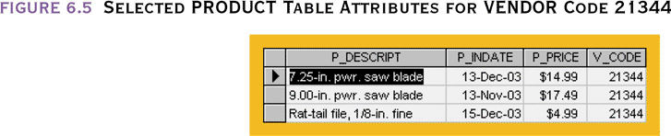
Selected PRODUCT Table Attributes for VENDOR Code 21344

Slide 36
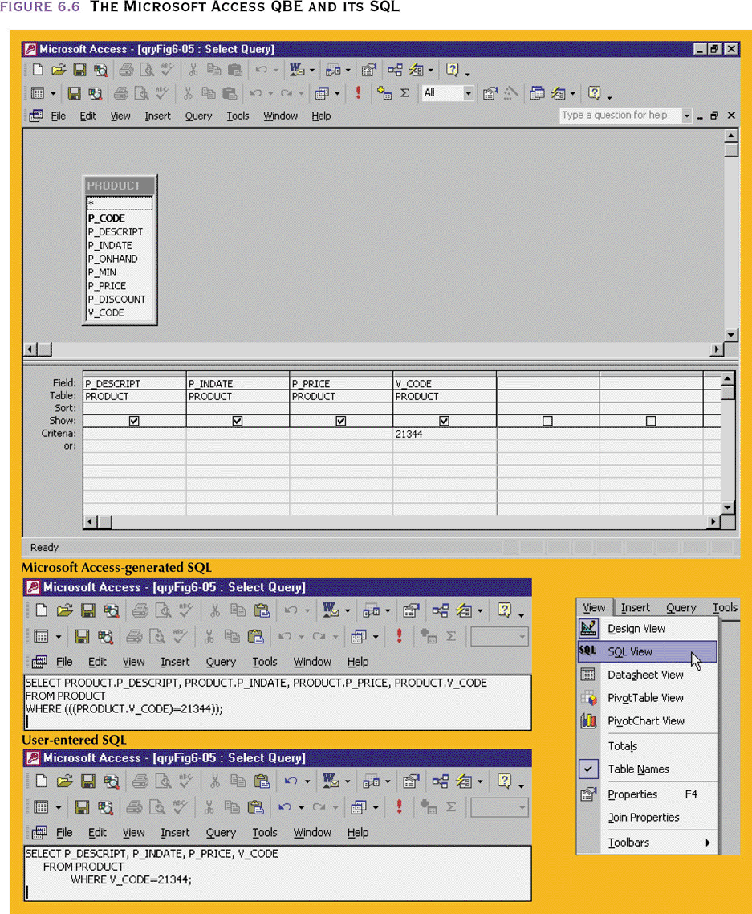
The Microsoft Access QBE and its SQL

Slide 37
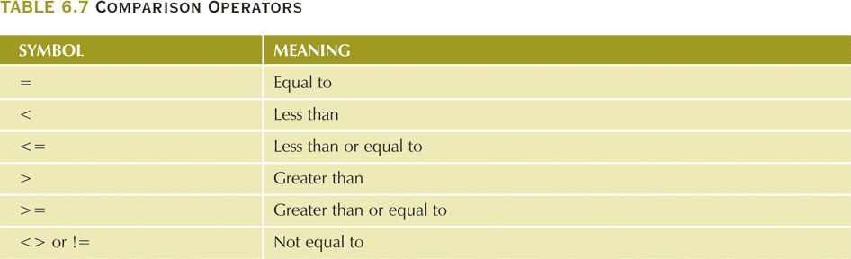
Comparison Operators

Slide 38
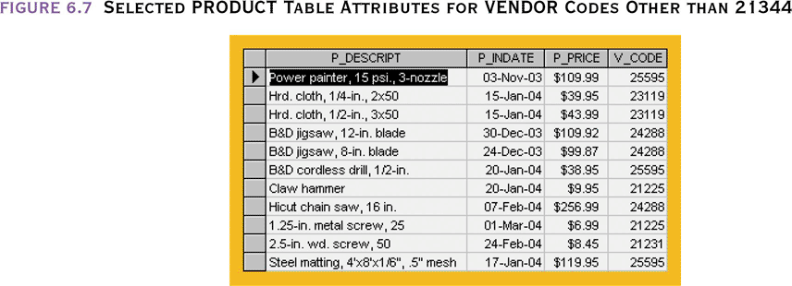
Selected PRODUCT Table Attributes for VENDOR Codes Other than 21344

Slide 39
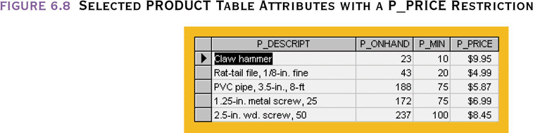
Selected PRODUCT Table Attributes with a P_PRICE Restriction
P_PRICE <=10

Slide 40
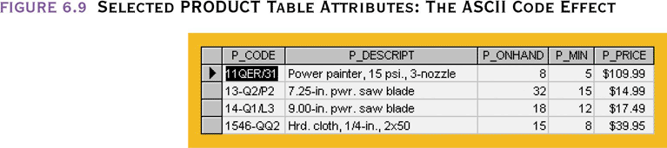
Selected PRODUCT Table Attributes:
The ASCII Code Effect
P_CODE < ‘15558-QW1’

Slide 41
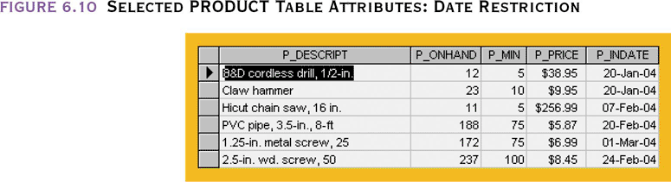
Selected PRODUCT Table Attributes: Date Restriction
P_INDATE>= ’20-Jan-2004’
Access uses # for date delimeter

Slide 42
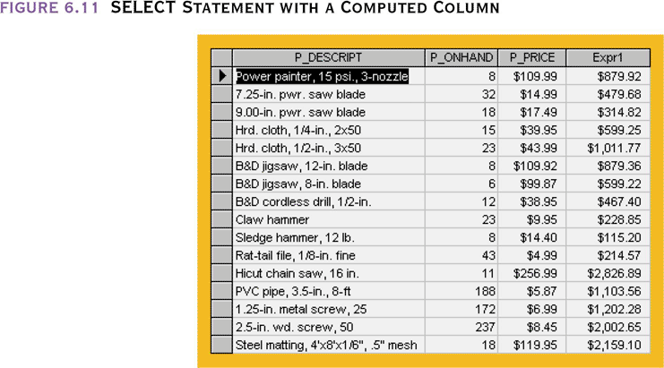
SELECT Statement with a Computed Column
SELECT P_ONHAND*P_PRICE FROM PRODUCT

Slide 43
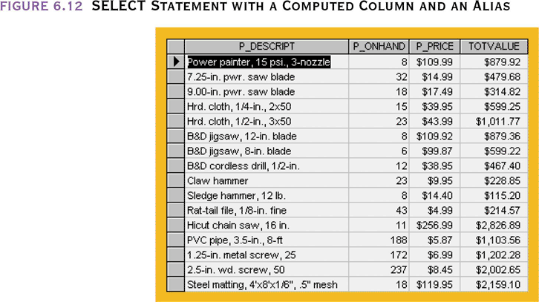
SELECT Statement with a Computed Column and an Alias
SELECT P_ONHAND*P_PRICE AS TOTVALUE FROM PRODUCT

Slide 44
SELECT statement: date computations
SELECT P_CODE, P_INDATE, DATE()-90 AS CUTDATE FROM PRODUCT WHERE P_INDATE <=DATE()-90;
SELECT P_CODE, P_INDATE, P_INDATE+90 AS EXPDATE FROM PRODUCT;

Slide 45
Arithmetic Operators:
The Rule of Precedence
Perform operations within parentheses
Perform power operations
Perform multiplications and divisions
Perform additions and subtractions

Slide 46
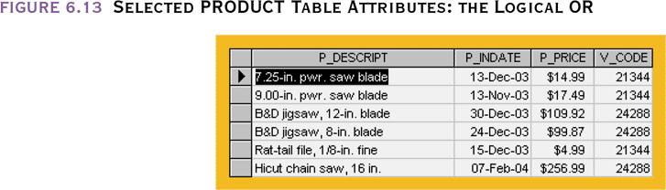
Selected PRODUCT Table Attributes:
The Logical OR
V_CODE=21344 OR V_CODE=24288

Slide 47
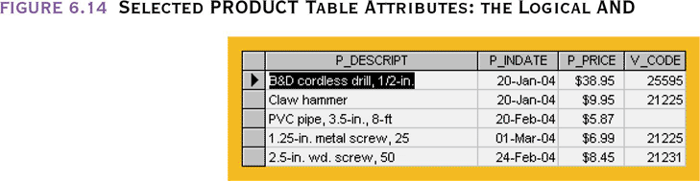
Selected PRODUCT Table Attributes:
The Logical AND
P_PRICE < 50
AND
P_INDATE>
’15-Jan-2004’

Slide 48
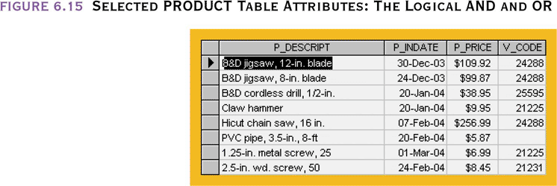
Selected PRODUCT Table Attributes:
The Logical AND and OR
(P_PRICE <50 AND
P_INDATE>
’15-Jan-2004’)
OR
V_CODE=24288

Slide 49
Special Operators
BETWEEN
  Used to check whether attribute value is within a range P_PRICE BETWEEN 50.00 AND 100.00
IS NULL
  Used to check whether attribute value is null
LIKE
  Used to check whether attribute value matches a given string pattern V_CONTACT [NOT] LIKE ‘Smith*’
  MS Access uses * and ? instead of % and _

Slide 50
Special Operators
IN
  Used to check whether attribute value matches any value within a value list
    V_CODE IN (21344,24288) if numeric
    SELECT V_CODE, V_NAME FROM VENDOR
    WHERE V_CODE IN
    (SELECT V_CODE FROM PRODUCT)
EXISTS
  Used to check if a subquery returns any rows
    SELECT * FROM VENDOR
    WHERE EXISTS
    (SELECT * FROM PRODUCT
    WHERE P_ONHAND <=P_MIN)

Slide 51
Advanced Data Definition Commands
All changes in the table structure are made by using the ALTER command
  Followed by a keyword that produces specific change
  Three options are available
    ADD
    MODIFY
    DROP

Slide 52
Changing a Column’s Data Type
ALTER can be used to change the data type from integer to character
  ALTER TABLE PRODUCT
  MODIFY(V_CODE CHAR(5));
  If V_CODE in PRODUCT references the same field in VENDOR, there will be a referential integrity violation
Some RDBMSs (such as Oracle) do not permit changes to data types unless the column to be changed is empty

Slide 53
Changing a Column’s Data Characteristics
Use ALTER to change data characteristics – increase the width of P_PRICE
  ALTER TABLE PRODUCT
  MODIFY(P_PRICE DECIMAL(9,2));
If the column to be changed already contains data, changes in the column’s characteristics are permitted if those changes do not alter the data type
Some databases will allow you to increase but not decrease the width of a column

Slide 54
Adding or Dropping a Column
Use ALTER to add a column
  ALTER TABLE PRODUCT
  ADD(P_SALECODE CHAR(1));
  Do not include the NOT NULL clause for new column because when it is added to an existing row it will default to NULL. It can be added to the table structure after all the data has been entered
Use ALTER to drop a column
  ALTER TABLE PRODUCT
  DROP COLUMN V_ORDER;
  Some RDBMSs impose restrictions on the deletion of an attribute e.g., if involved in a FK relationship

Slide 55
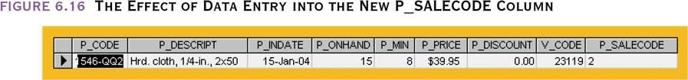
The Effect of Data Entry into the New P_SALECODE Column
UPDATE PRODUCT
SET P_SALECODE = ‘2’
WHERE P_CODE = ‘1546-QQ2’

Slide 56
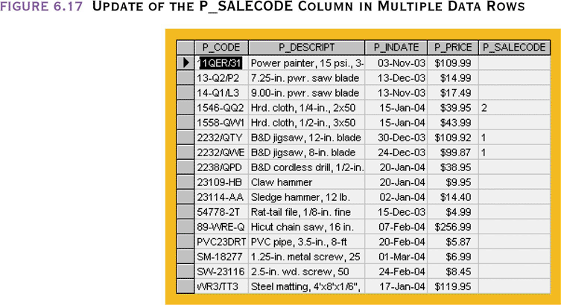
Update of the P_SALECODE Column in Multiple Data Rows
UPDATE PRODUCT
SET P_SALECODE = ‘1’
WHERE P_CODE IN (‘2232/QWE’,
’2232/QTY’);

Slide 57
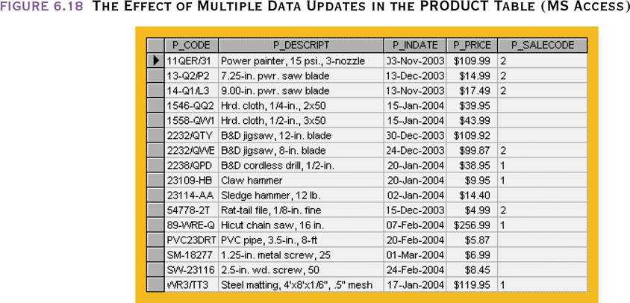
The Effect of Multiple Data Updates in the PRODUCT Table
UPDATE PRODUCT
SET P_SALECODE = ‘2’
WHERE P_INDATE <’25-Dec-2003’;
UPDATE PRODUCT
SET P_SALECODE = ‘1’
WHERE P_INDATE >=’16-Jan-2004’
AND
P_INDATE
<=’10-Feb-2004’;

Slide 58
Updates with Arithmetic Operators
UPDATE PRODUCT
SET P_ONHAND = P_ONHAND+2
WHERE P_CODE=‘2232/QWE’;
UPDATE PRODUCT
SET P_PRICE = P_PRICE*1.10
WHERE P_PRICE < 50.00;

Slide 59
Copying Parts of Tables
SQL permits copying contents of selected table columns so that the data need not be reentered manually into newly created table(s)
First create the PART table structure
  Row names need not be the same nor the number of columns as the original table but those columns being copied must have the same attributes
Next add rows to new PART table using PRODUCT table rows

Slide 60
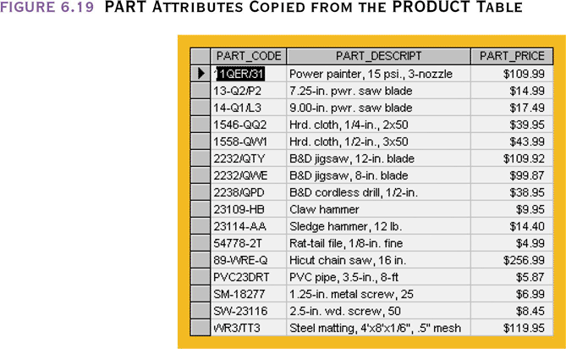
PART Attributes Copied from the PRODUCT Table
INSERT INTO PART
(PART_CODE, PART_DESCRIP,
PART_PRICE)
SELECT P_CODE, P_DESCRIPT,
P_PRICE
FROM PRODUCT;

Slide 61
Creating the PART table and Copying from the PRODUCT in One Step
CREATE TABLE PART AS
SELECT
P_CODE AS PART_CODE,
P_DESCRIPT AS PART_DESCRIPT,
P_PRICE AS PART_PRICE
FROM PRODUCT;
Column names need not be identical
New table need not have the same number of columns as the original
No entity integrity (PK) or referential integrity (FK) rules are automatically applied to the new table

Slide 62
Additional SQL Operations
You can add primary (single and composite) and foreign keys using the ALTER command
ALTER TABLE LINE
ADD PRIMARY KEY(INV_NUMBER,LINE_NUMBER),
ADD FOREIGN KEY (INV_NUMBER) REFERENCES INVOICE,
ADD FOREIGN KEY (PROD_CODE) REFERENCES PRODUCT;
Deleting a table from the database
DROP TABLE PART;

Slide 63
Additional SQL Operations
Ordering a listing
SELECT P_CODE, P_DESCRIPT, P_INDATE, P_PRICE
FROM PRODUCT
ORDER BY P_PRICE;
ORDER BY P_PRICE DESC puts the listing in descending order
Cascading order sequence – multilevel ordering
  You can also include a WHERE clause before the ORDER clause
SELECT EMP_LNAME, EMP_FNAME, EMP_INITIAL, EMP_AREACODE, EMP_PHONE FROM EMPLOYEE
WHERE EMP_AREACODE IN (‘718’, ‘212’)
ORDER BY
EMP_LNAME, EMP_FNAME, EMP_INITIAL;

Slide 64
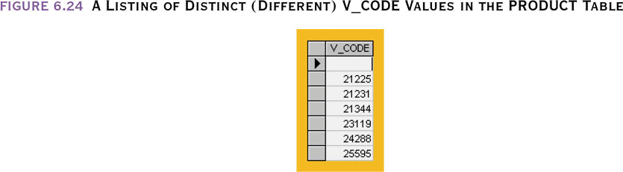
Additional SQL Operations
Listing unique values – find out how many different vendors are in the PRODUCT table
SELECT DISTINCT V_CODE FROM PRODUCT;

Slide 65
Advanced Select Queries
SQL provides useful functions
  Count
  Sum
  Find minimum and maximum values
  Calculate averages
SQL allows the user to limit queries to only those entries having no duplicates or entries whose duplicates may be grouped

Slide 66
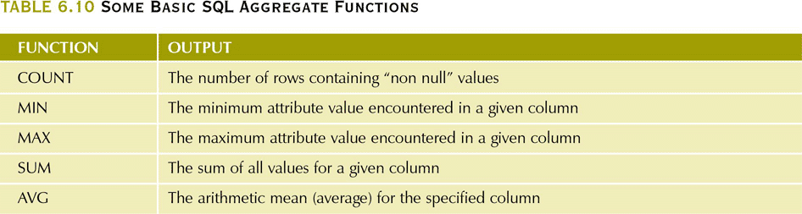
Some Basic SQL Aggregate Functions

Slide 67
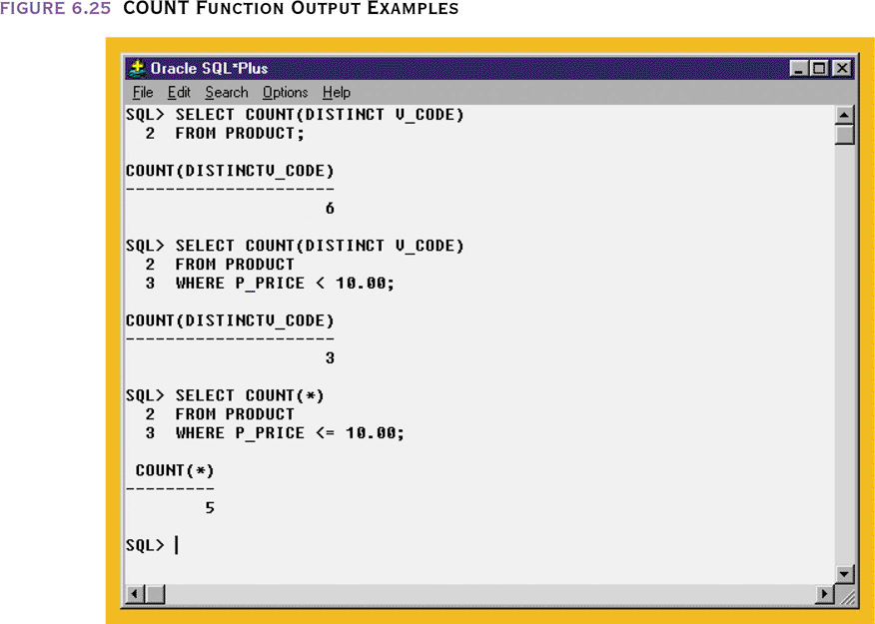
COUNT Function Output Examples
COUNT(*) allows us to find out how many rows in PRODUCT have a P_PRICE <= $10.00
Includes rows that contain nulls, other COUNTs do not include rows with nulls
MS Access does not allow the use of COUNT with DISTINCT
Use SELECT COUNT(*) FROM SELECT DISTINCT V_CODE WHERE V_CODE IS NOT NULL

Slide 68
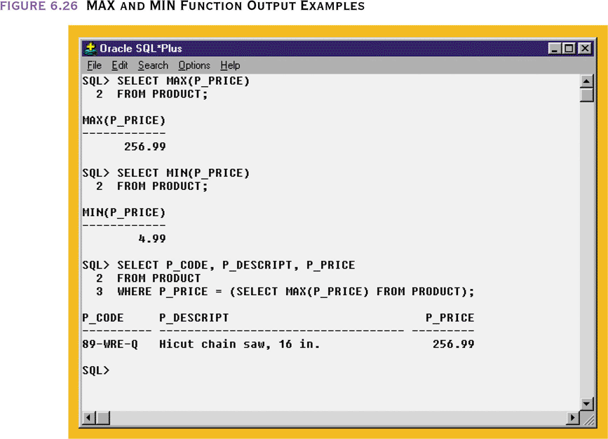
MAX and MIN Function Output
Can not use WHERE P_PRICE = MAX(P_PRICE)

Slide 69
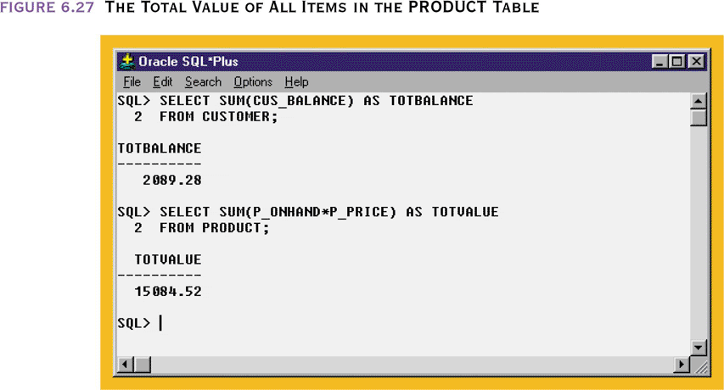
The Total Value of All Items in the PRODUCT Table

Slide 70
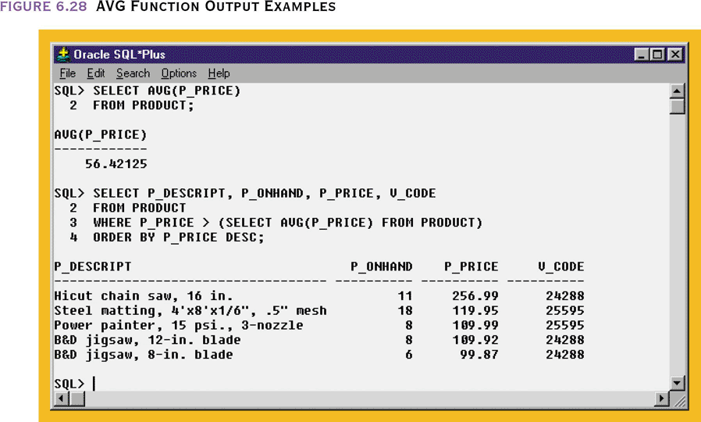
AVG Function Output Examples

Slide 71
GROUP BY Clause
The SELECT’s columnlist must include a combination of column names and aggregate functions
The GROUP BY clause’s columnlist must include all non-aggregate function columns specified in the SELECT’s columnlist.
  If required, you could also group by an aggregate function columns that appear in the SELECT’s columnlist
The GROUP BY clause columnlist can include any columns from the tables in the FROM clause of the SELECT statement, even if they do not appear in the SELECT columnlist

Slide 72
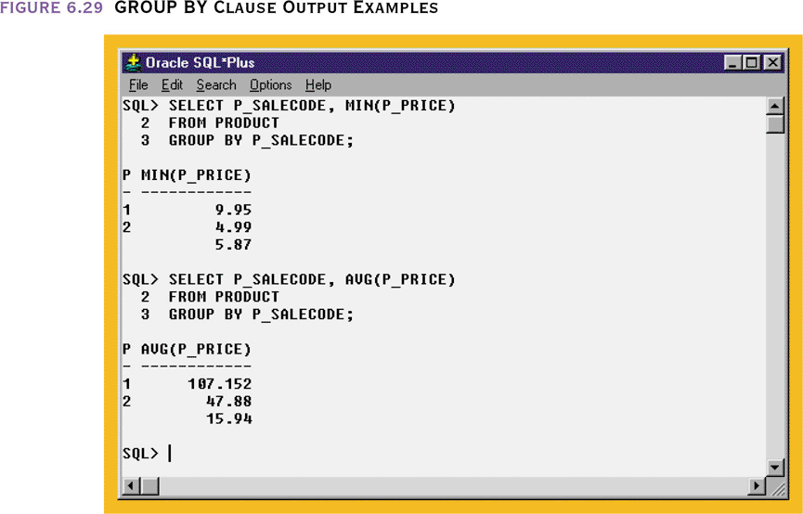
GROUP BY Clause Output Examples
← Note that nulls are included in the output

Slide 73
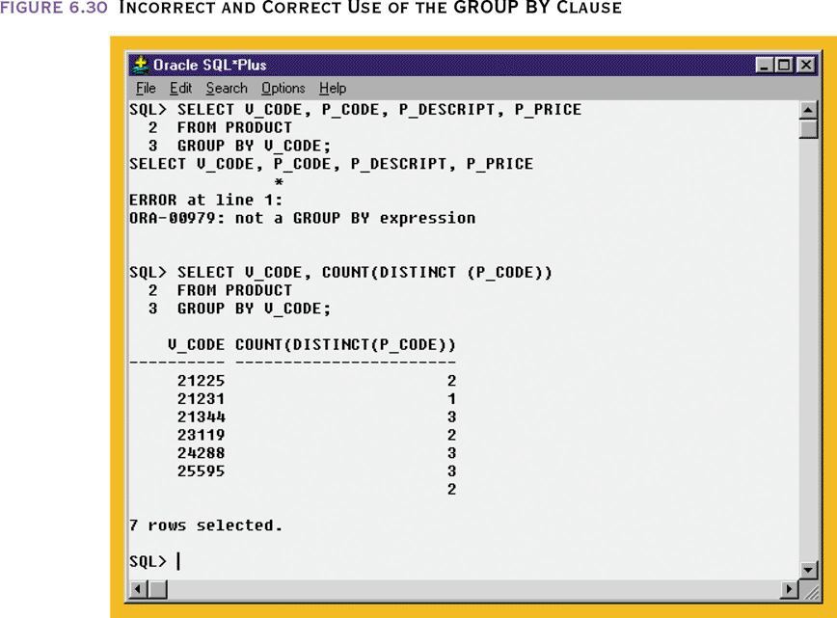
Incorrect and Correct Use of the GROUP BY Clause
GROUP BY requires an aggregate function
The number of products supplied by each vendor

Slide 74
An Application of the HAVING Clause
HAVING operates like the WHERE clause in the SELECT statement except…
  WHERE applies to columsn and expressions for individual rows
  HAVING is applied to the output of a GROUP operation

Slide 75
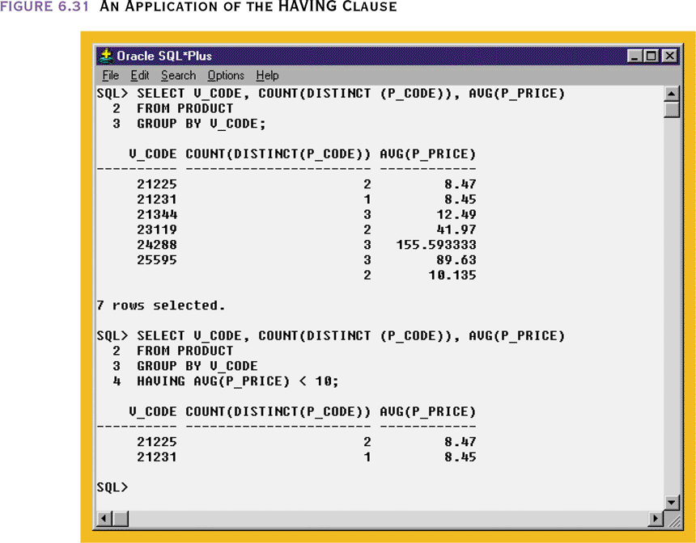
An Application of the HAVING Clause
Number of products supplied by each vendor with the average price
Number of products supplied by each vendor with the average price <= $10.00

Slide 76
Virtual Tables: Creating a View
View is a virtual table based on a SELECT query
  Can contain columns, computed columns, aliases, and aggregate functions from one or more tables
Base tables are tables on which the view is based
Create a view by using the CREATE VIEW command
  Not supported in MS Access

Slide 77
Virtual Tables: Creating a View
You can use the name of a view anywhere a table is expected in a SQL statement
Views are dynamically updated – it is recreated each time it is invoked
Views can be restrict users to see only specified columns and rows in a table
They can be used as the basis of a report
  CREATE VIEW XYZ AS SELECT … FROM … GROUP BY …;

Slide 78
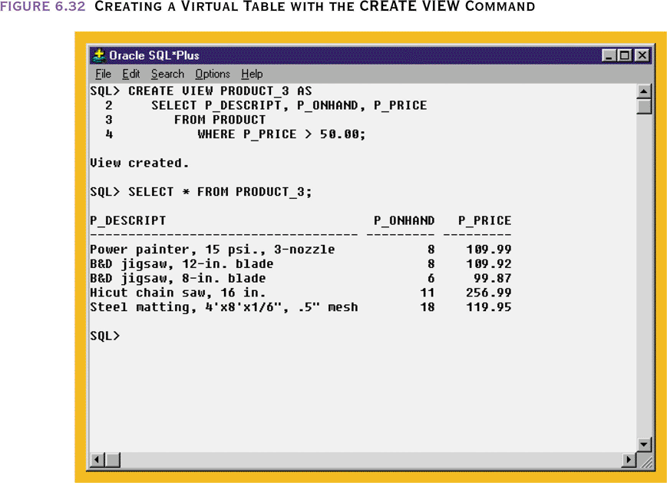
Creating a Virtual Table with the CREATE VIEW Command

Slide 79
Joining Database Tables
Ability to combine (join) tables on common attributes is most important distinction between a relational database and other databases
Join is performed when data are retrieved from more than one table at a time
Join is generally composed of an equality comparison between the foreign key and the primary key of related tables
  If you join N tables, you need N-1 join conditions
The order of the output may be different each time you produce a listing. Use ORDER BY to have predictable results

Slide 80
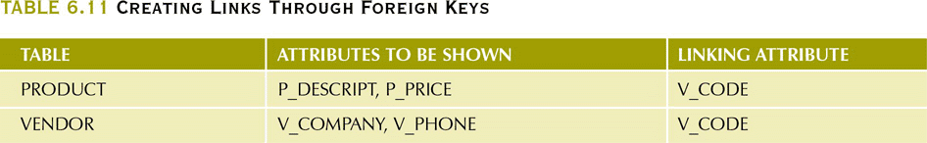
Creating Links Through Foreign Keys

Slide 81
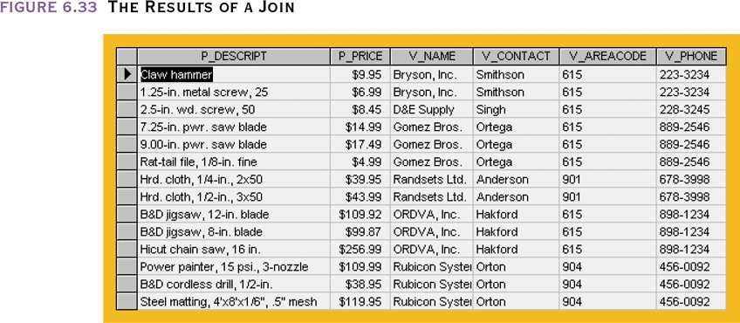
The Results of a Join
SELECT PRODUCT.P_DESCRIPT, PRODUCT.P_PRICE,
VENDOR.V_NAME, VENDOR.V_CONTACT, VENDOR.V_AREACODE, VENDOR.V_PHONE
FROM PRODUCT, VENDOR
WHERE PRODUCT.V_CODE = VENDOR.V_CODE;
(NOTE: table name not needed in columnlist if unambiguous)

Slide 82
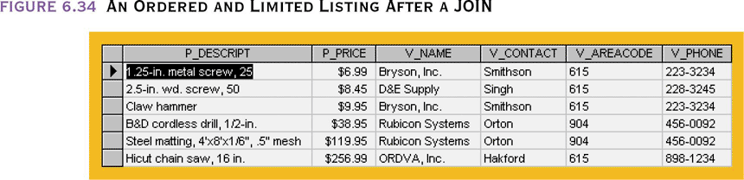
An Ordered and Limited Listing
After a JOIN
SELECT P_DESCRIPT, P_PRICE, V_NAME, V_CONTACT, V_AREACODE, V_PHONE
FROM PRODUCT, VENDOR
WHERE PRODUCT.V_CODE = VENDOR.V_CODE
AND P_INDATE > 15-JAN-2004’;
You can give a table an ALIAS to shorten coding
FROM PRODUCT P, VENDOR V
WHERE P.V_CODE = V.V_CODE
MS Access uses FROM PRODUCT AS P

Slide 83
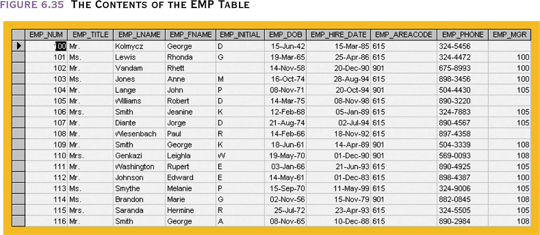
The Contents of the EMP Table
From this table, generate a list of employees
with their manager’s name

Slide 84
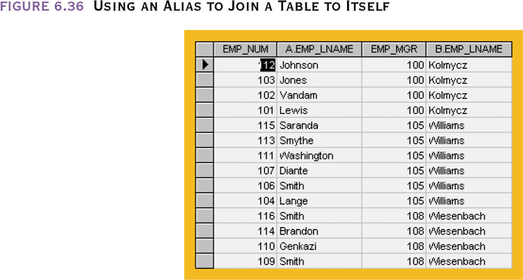
Using an Alias to Join a Table to Itself
SELECT E.EMP_MGR, M.EMP_LNAME, E.EMP_NUM, E.EMP_LNAME FROM EMP E, EMP M
WHERE E.EMP_MGR = M.EMP_NUM
ORDER BY E.EMP_MGR;

Slide 85
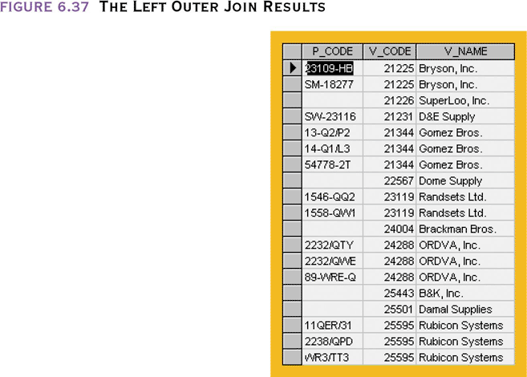
The Left Outer Join Results
SELECT P_CODE,
VENDOR.V_CODE, V_NAME
FROM VENDOR
LEFT JOIN PRODUCT ON
VENDOR.V_CODE =
PRODUCT.V_CODE
Shows all VENDOR rows and all matching PRODUCT rows

Slide 86
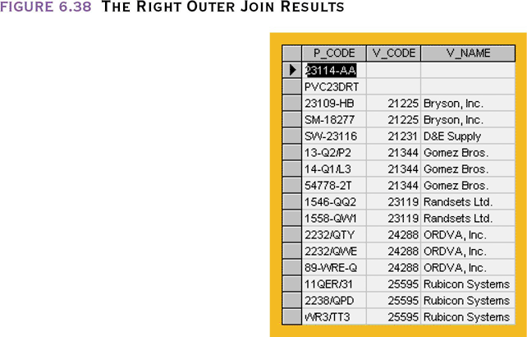
The Right Outer Join Results
SELECT PRODUCT. P_CODE,
VENDOR.V_CODE, V_NAME
FROM VENDOR
RIGHT JOIN PRODUCT ON
VENDOR.V_CODE =
PRODUCT.V_CODE
Shows all PRODUCT rows and all matching VENDOR rows

